Slide 1


PI-20
Mojaloop
Community
Awards

Slide 2
Q3 2022
Builders
Contributor
Participants
Explorers
17
No Level
4
70
106
78
Notes:
This pulls orbit level for Q3 2022

Slide 3
Mojaloop Training Program
Quick update on Q3

Slide 4
User Data & Course Completion-Q3 2022
 | End Q3 | Totals | % ↑ in Q3
Total Users | 107 | 950 | + 13%
Total Countries | 94 | 94
 | Enrolled | Completion | Total Enrollments-Q2 and Q3*
Moja 101 | 82 | 21 | 90
Moja 102 | 47 | 12 | 49
Moja 103 | 23 | 7 | 1
Moja 104 | 10 | 5 | 10
DFSP 101 | 8 | 1 | 14
DFSP 209 | 4 | 0 | 4
Scheme 101 | 9 | 2 | 9
HUB 101 | 20 | 7 | 20
HUB 209 | 11 | 0 | 11
TTK | 9 | 0 | 9
*Q2 is Partial to New Training Platform being Launched

Slide 5
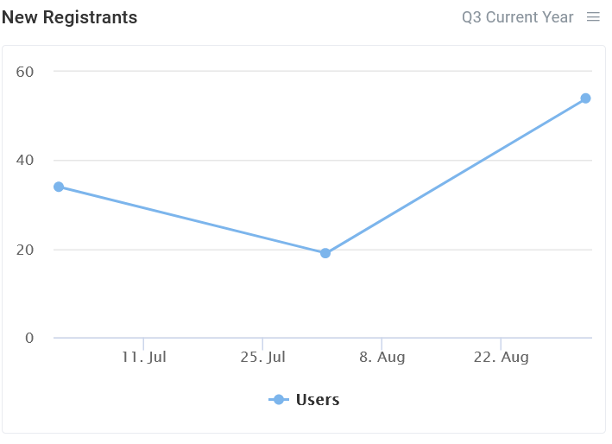
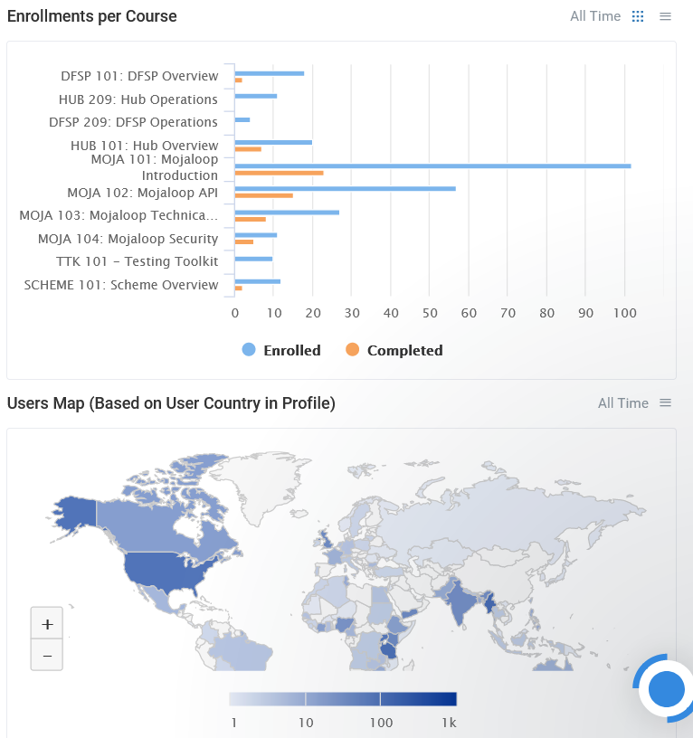
Course Activity – Q3 2022

Slide 6
Awards Time!
Active Community Members
New & Promising Members
Special Recognition

Slide 7
Active Community Members
Recognizing Community Members who have actively contributed to the development of Mojaloop

Slide 8
Active Community Members
Q3 2022
Miguel de Barros
Kevin Leyow
Vijay Guthi
Sridevi Miriyala
Pedro Barreto
Paul Baker
Sam Kummary
Yevhen Kyriukha
Michael Richards
Godfrey Kutumela
Notes:
Pulled from Leaderboard in quarterly stats run

Slide 9
New & Promising Community Members
Recognizing new and promising Community Members who have engaged actively in the Mojaloop ecosystem

Slide 10


New & Promising Community Members
2022 Q3
Gift Agboro
Rui Rocha
Elifraha Natai
Danish Jamal
Jake Kendall
Avik Ganguly
José Francisco Antunes
Sherwin – Busy Bee
Zbyszek Tenerowicz
Joseph Benson-Aruna
Notes:
Pulled from Q1 leaderboard in regular stats run

Slide 11
Special Recognition
Recognizing significant contributions by Mojaloop community members

Slide 12
Special Recognition
Desire Kachenje – Walk the Loop

Slide 13
Notices & Reminders

Slide 14
Updating PI Schedule
3 Program Increments (PI) per year instead of 4
Longer period to get more done
More Formal mid-PI checkins
3 Convenings a year
Beginning of March 2023: In-person
End of June 2023: Virtual
End of October 2023: In-person

Slide 15
10 days
8 days
3 days
4 days
3 days
1 day
2022
Mojaloop Community Governance Elections
Thur 27.Oct - Fri 4.Nov
Nomination / Register to vote Period
Mon 7.Nov - Thu 10.Nov
Slate preparation
Fri 11.Nov - Tue 15.Nov
Voting Period
Wed 16.Nov - Fri 18.Nov
Confirmation period
Mon 21.Nov
Blog announcement of members for each committee
Transition Week - Committee initial meetings
Mon 21.Nov - Fri 2.Dec
2022
10/23
10/30
11/06
11/13
11/20
11/27
Today

Slide 16
2022 Election Slate
Community Council (9 openings)
Design Authority (5 openings)
Change Control Board (2 openings)
Rapporteur (Chair)
Convenor

Slide 17
Congratulations
to all our community members who received recognition during the PI-20 Community Meeting for their outstanding contribution to the Mojaloop Open Source Project

